Slide 1
Course Name: Database Management System
Course Code: CS116
Dr. Praveen Kantha

Slide 2
NORMALIZATION

Slide 3
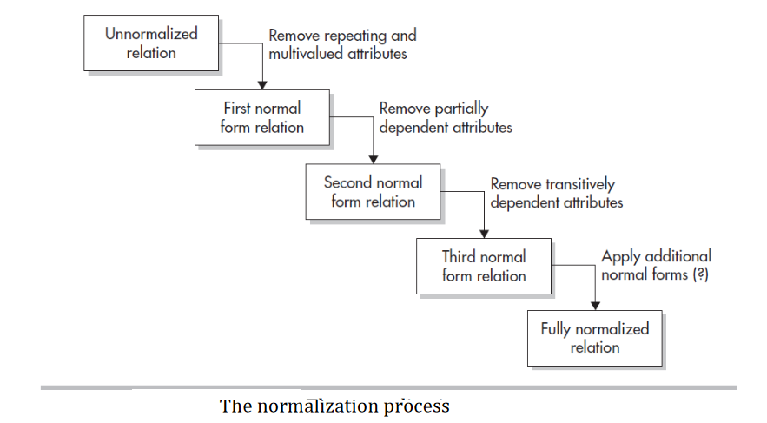

Slide 4
Database Normalization
Normalization is the process of reorganizing data in a database so that it meets two basic requirements:
There is no redundancy of data.
Data dependencies are logical.
Normalization usually involves dividing a database into two or more tables and defining relationships between the tables.

Slide 5
Purpose of Normalization
Minimise redundancy in data
Remove insert, delete, and update anomalies during database activities
Reduce the need to reorganize data when it is modified or enhanced.
Normalization reduces a complex user view into a number of subgroups

Slide 6
Levels of normalization are based on the amount of redundancy in the database.
Various levels of normalization are:
First Normal Form (NF)
Second Normal Form (2NF)
Third Normal Form (NF)
Boyce-Codd Normal Form (BOF)
Fourth Normal Form (4NF)
Fifth Normal Form (5NF)

Slide 7
1st Normal Form (1NF)
The first Normal Form defines that all the attributes in a relation must have atomic domains. The values in an atomic domain are indivisible units.
The first Normal Form enforces these Criteria:
Place all items that appear in the repeating group in a new table.
Designate a primary key for each new table produced.
Duplicate in the new table the primary key of the table from which the repeating group was extracted or vice versa.

Slide 8
ECODE | DEPT | DEPT_HEAD | PROJ_CODE | HOURS
E101 | SYSTEM | E901 | P27 | 90
 |  |  | P51 | 101
 |  |  | P20 | 60
E305 | SALES | E906 | P27 | 109
E508 | ADMIN | E907 | P51 | NULL
 |  |  | P27 | 755
This table contains Attribute values that are not single. This is not in Normalised form.
To make it into 1NF we have to decompose the table into atomic elements.
UNF

Slide 9
Table in 1 NF after eliminating
ECODE | DEPT | PROJ_CODE | DEPT_HEAD | HOURS
E101 | SYSTEM | P27 | E901 | 90
E101 | SYSTEM | P51 | E901 | 101
E101 | SYSTEM | P20 | E901 | 60
E305 | SALES | P27 | E906 | 109
E508 | ADMIN | P51 | E907 | NULL
E508 | ADMIN | P27 | E907 | 755
Now it is in 1 NF

Slide 10
Second Normal Form - 2NF
Prime attribute - an attribute, that is a part of the prime key, is known as a prime attribute.
Non-prime attribute - an attribute, that is not a part of the prime key, is said to be a non-prime attribute.
The steps for converting a database to second Normal Form (2NF):
A table is said to be in second normal form when it is in 1 NF.
Every non-prime attribute should be fully functionally dependent on the prime key attribute and there should not be any partial dependency (Depend on the Whole Key not just a part of the Key).
In the second normal form, We remove Partial Dependency

Slide 11
From the First Normal Form
The Primary Key here is the Composite Key (Ecode + ProjCode).
(Ecode + ProjCode) functionally determine Hours.
Ecode functionally determines Dept.
Attribute Dept has no dependency on Projcode.
(Ecode + ProjCode) -> Hours
Ecode -> Dept
So, Dept is Partial Depend on PROJ_CODE
ECODE
PROJ_CODE
HOURS
DEPT
DEPT_HEAD
ECODE
DEPT
So, Remove
Partial Dependency
ECODE
PROJ_CODE
HOURS

Slide 12
From the First Normal Form
The Primary Key here is the Composite Key (Ecode + ProjCode).
(Ecode + ProjCode) functionally determine Hours.
Ecode functionally determines Dept.
Attribute Dept has no dependency on Projcode.
ECODE
PROJ_CODE
HOURS
DEPT
DEPT_HEAD
ECODE
DEPT
So, Remove
Partial Dependency
ECODE
PROJ_CODE
HOURS

Slide 13
Table in 2 NF after eliminating
ECODE | DEPT | DEPT_HEAD
E101 | SYSTEM | E901
E305 | SALES | E906
E508 | ADMIN | E907
ECODE | PROJ_CODE | HOURS
E101 | P27 | 90
E101 | P51 | 101
E101 | P20 | 60
E305 | P27 | 109
E508 | P51 | NULL
E508 | P27 | 755
Now it is in 2 NF

Slide 14
Third Normal Form - 3NF
The steps for converting a database to Third Normal Form (3NF):
Remove Transitive Dependeny.
A Table is said to be in 3NF, when it is in 2NF and every non-key attribute is functionally dependent on just Primary Key.
ECode - > Dept
Dept -> Dept_Head
So, Dept_Head is transitively dependent on Ecode
Here Dept is dependent on Ecode and Dept_Head is dependent on Dept So, Dept_Head is transitively dependent on Ecode.
Here, In 3NF, We remove Transitive Dependency.

Slide 15
ECODE | DEPT | DEPT_HEAD
E101 | SYSTEM | E901
E305 | SALES | E906
E508 | ADMIN | E907
ECODE | DEPT
E101 | SYSTEM
E305 | SALES
E508 | ADMIN
DEPT | DEPT_HEAD
SYSTEM | E901
SALES | E906
ADMIN | E907
Now it is in 3 NF

Slide 16


Slide 17
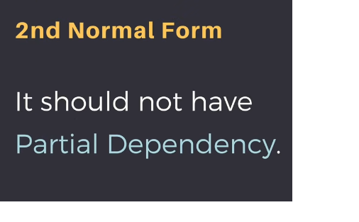

Slide 18
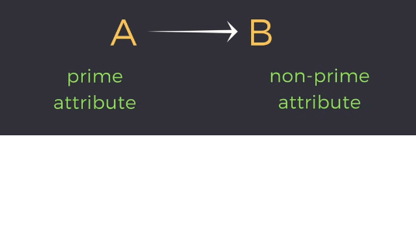
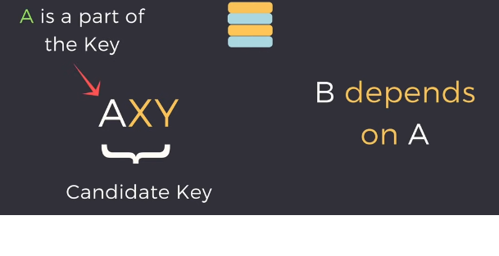

Slide 19
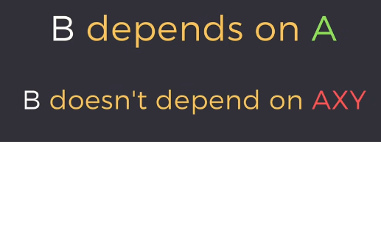


Slide 20

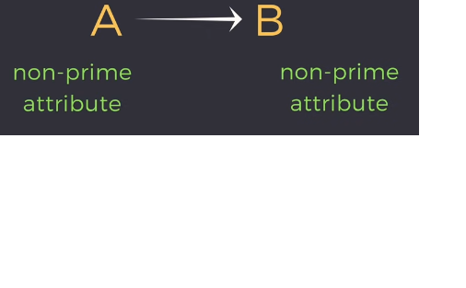


Slide 21
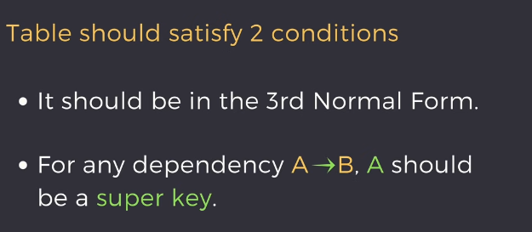

Slide 22



Slide 23
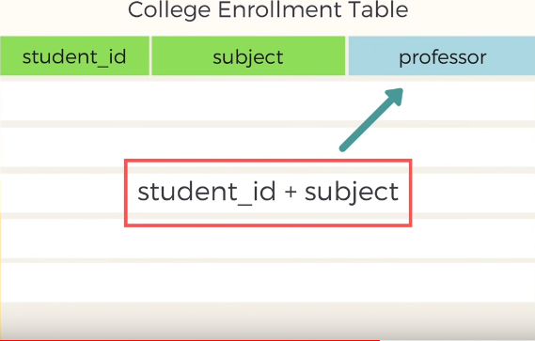

Slide 24


Slide 25
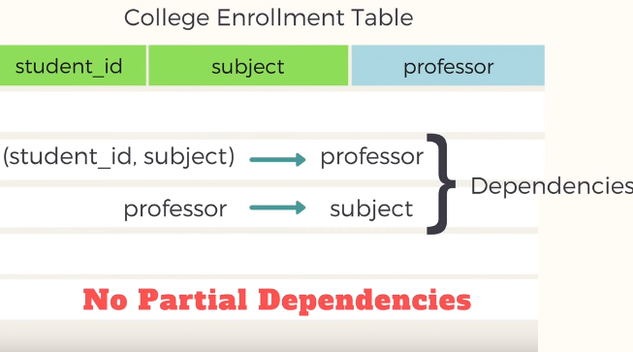

Slide 26
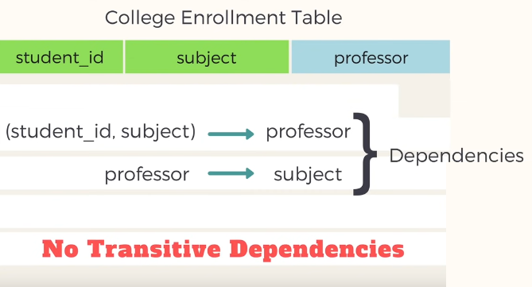

Slide 27


Slide 28


Slide 29



Slide 30
How to find the highest normal form of a relation
Find all possible candidate keys of the relation.
Divide all attributes into two categories: prime attributes and non-prime attributes.
Check for 1st normal form then 2nd and so on. If it fails to satisfy the n^{th} normal form condition, the highest normal form will be n-1.

Slide 31
Example 1. Find the highest normal form of a relation R(A,B,C,D,E) with FD set {A->D, B->A, BC->D, AC->BE}
Step 1. As we can see, (AC)⁺ ={A, C, B, E, D} but none of its subsets can determine all attributes of the relation, So AC will be the candidate key. A can be derived from B, so we can replace A in AC with B. So BC will also be a candidate key. So there will be two candidate keys {AC, BC}.
Step 2. The prime attribute is those attribute which is part of the candidate key {A, B, C} in this example and others will be non-prime {D, E}.
Step 3. The relation R is in 1st normal form as a relational DBMS does not allow multi-valued or composite attributes.
The relation is not in the 2nd Normal form because A->D is partial dependency (A which is a subset of candidate key AC is determining non-prime attribute D) and the 2nd Normal form does not allow partial dependency.
So the highest normal form will be the 1st Normal Form.

Slide 32
Example 2. Find the highest normal form of a relation R(A,B,C,D,E) with FD set as {BC->D, AC->BE, B->E}

Slide 33
Example 2. Find the highest normal form of a relation R(A,B,C,D,E) with FD set as {BC->D, AC->BE, B->E}
Step 1. As we can see, (AC)⁺ ={A,C,B,E,D} but none of its subsets can determine all attributes of relation, So AC will be the candidate key. A or C can’t be derived from any other attribute of the relation, so there will be only 1 candidate key {AC}.
Step 2. The prime attribute is those attribute which is part of candidate key {A,C} in this example and others will be non-prime {B,D,E} in this example.
Step 3. The relation R is in 1st normal form as a relational DBMS does not allow multi-valued or composite attributes.
The relation is in 2nd normal form because BC->D is in 2nd normal form (BC is not a proper subset of candidate key AC) and AC->BE is in 2nd normal form (AC is candidate key) and B->E is in 2nd normal form (B is not a proper subset of candidate key AC).

Slide 34
The relation is not in 3rd normal form because in BC->D (neither BC is a super key nor D is a prime attribute) and in B->E (neither B is a super key nor E is a prime attribute) but to satisfy 3rd normal for, either LHS of an FD should be super key or RHS should be a prime attribute.
So the highest normal form of relation will be the 2nd Normal form.

